Slide 1
Introduction to the Framework for Unified Systems Engineering & Design of Wind Plants (FUSED-Wind)
March 4th, 2014
Katherine Dykes

Slide 2
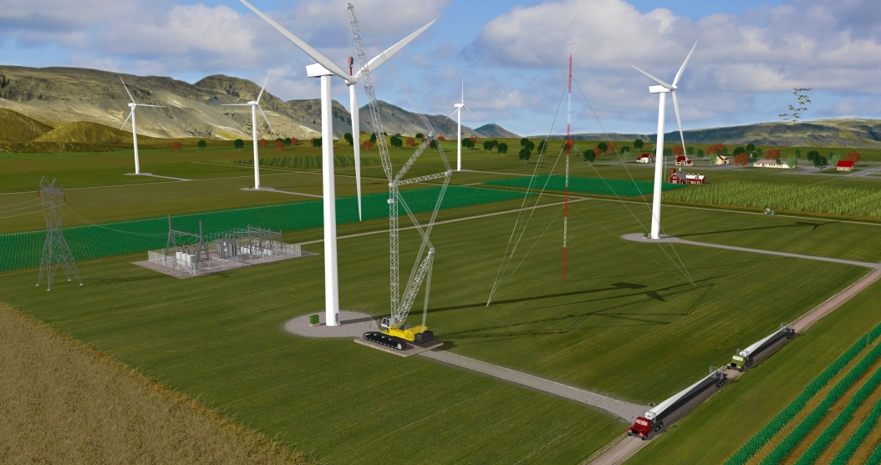
Introduction
Problem Statement:
A wind plant is a complex interconnected system with a large number of stakeholders (OEMs, suppliers, developers, contractors, operators, utilities, financiers, and communities)
Assessment of design improvements and new technology innovation impacts on overall system cost of energy is challenging and may limit adoption
Complex Wind Inflow
Community & Environmental Impacts
Plant Layout & Energy Production
Turbine Design & Performance
Grid Integration
Operational Expenditures
Balance of Station Costs
Plant Cost of Energy
Turbine Capital Costs
Notes:
Motivation: the complexity of wind energy technology, the limitations of current segmented analysis tools

Slide 3
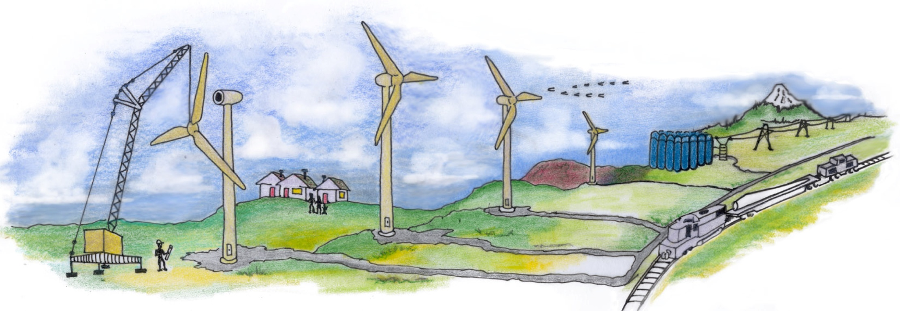
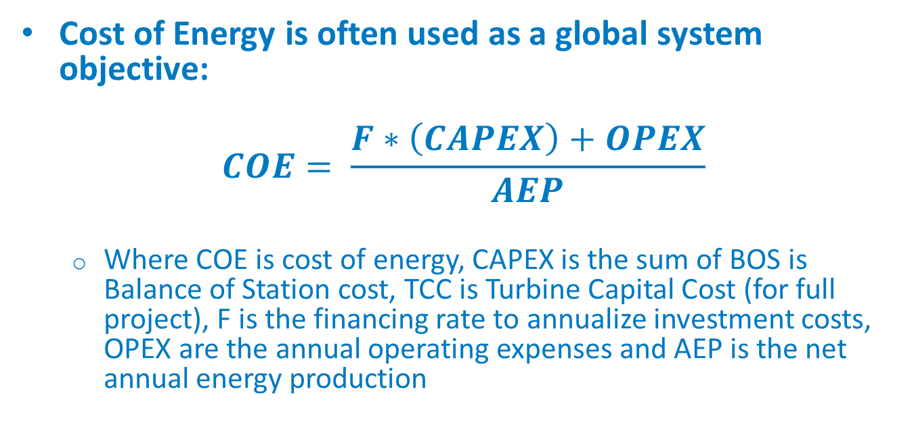
Wind Energy System Cost of Energy
Cost of Energy is often used as a global system objective:
$$COE= \frac{F∗\left(CAPEX\right)+OPEX}{AEP}$$
Where COE is cost of energy, CAPEX is the sum of BOS is Balance of Station cost, TCC is Turbine Capital Cost (for full project), F is the financing rate to annualize investment costs, OPEX are the annual operating expenses and AEP is the net annual energy production

Slide 4
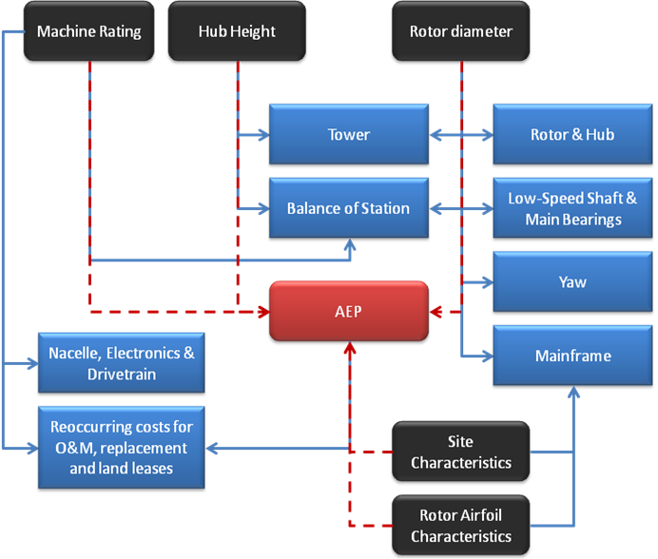
Determining Wind Cost of Energy
Current “NREL Cost and Scaling Model (NREL CSM)” uses parameterized functional relationships calibrated to historical trends
Originated with detailed design studies in early 2000s (WindPACT)
Abstraction to simple parametric relationships
Useful for two primary types of analyses on system costs:
Changing input factor prices over time
Scaling of conventional technology within a limited range
Publically available model
Current structure of cost model
Notes:
Specific limitations of current cost model (presentation focused on cost analysis team) in doing forward looking analysis

Slide 5
Wind Energy System Engineering
Systems Engineering approach involves:
Integrating wind plant engineering performance and cost software modeling to enable full system analysis.
Using models of multiple levels of fidelity for each part of the system.
Applying of a variety of advanced analysis methods in multidisciplinary design analysis and optimization (MDAO) and related fields (uncertainty analysis, etc).
FUSED-Wind goal is to develop a common platform and toolset to promote collaborative research and analysis among national laboratories, industry, and academia

Slide 6
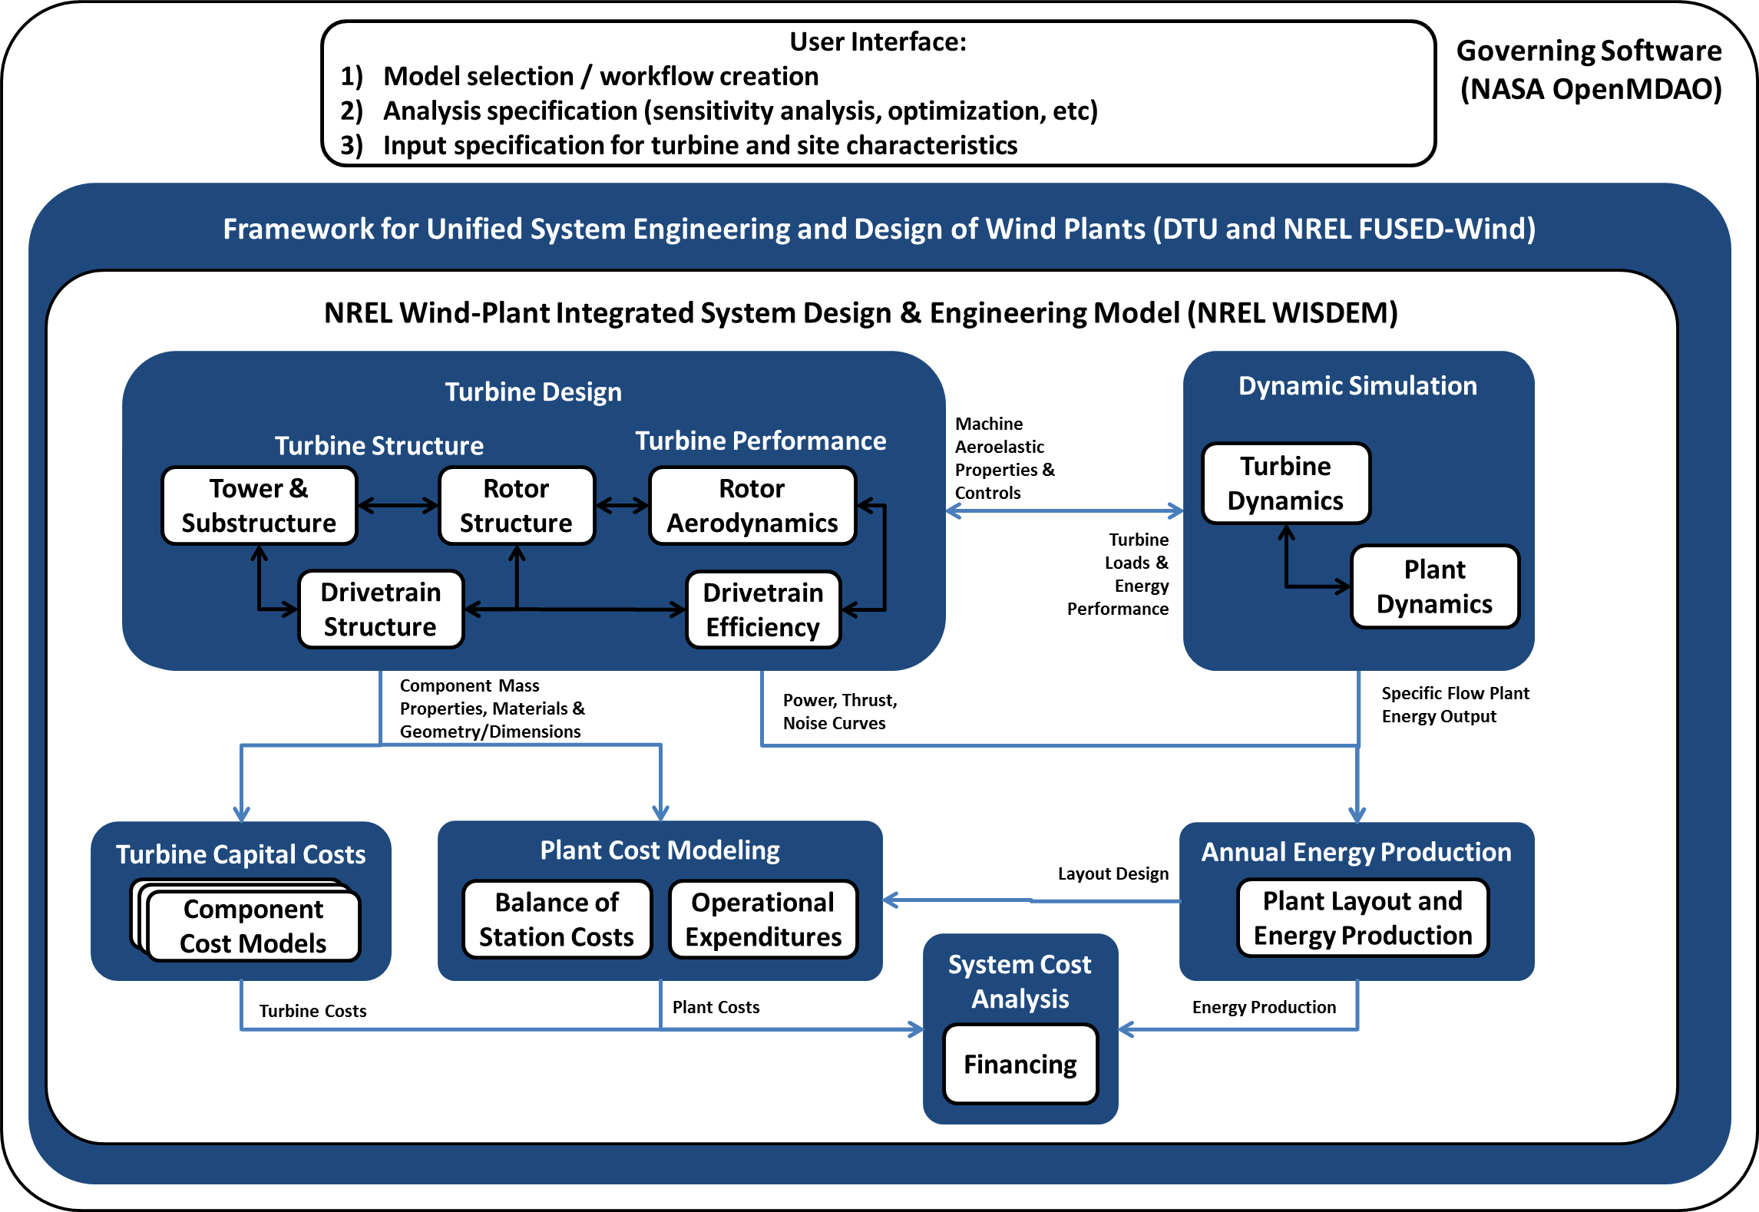
Systems Engineering Software Framework

Slide 7
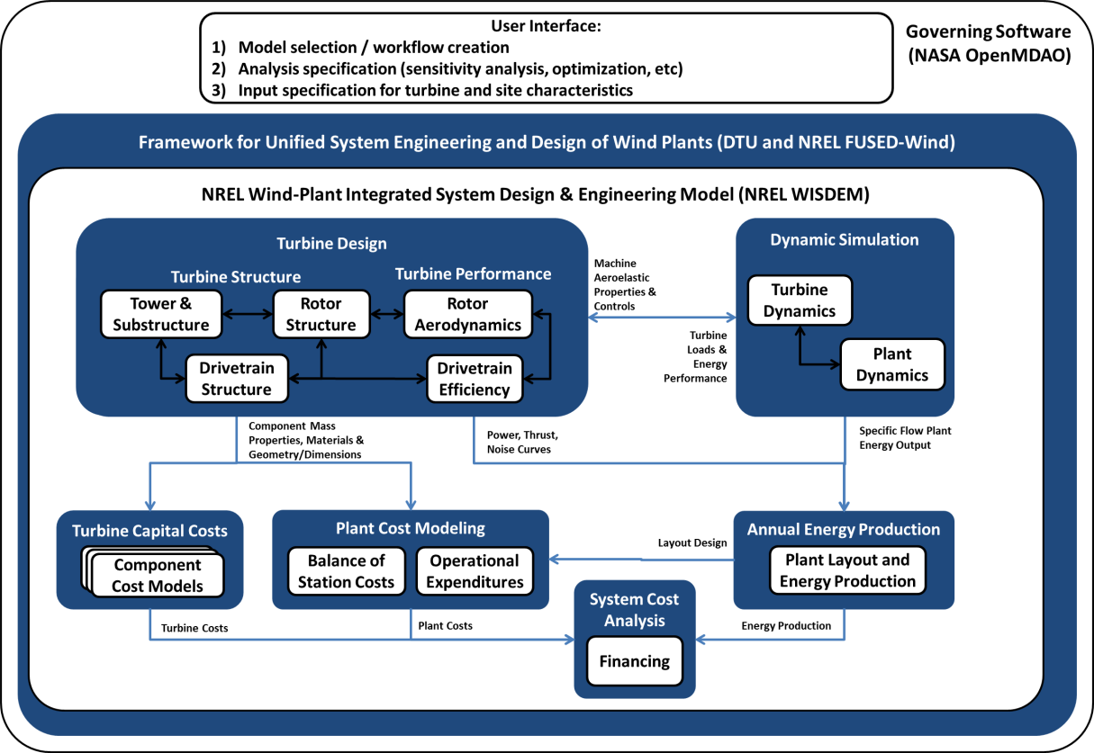
Systems Engineering Software Framework
FUSED-Wind:
Support software for structured interface of wind turbine and plant modeling tools in OpenMDAO
Collaboration between DTU Wind Energy and NREL
Allows interchange of models, sharing of common turbine and plant input descriptions
OpenMDAO:
Work flows integrate models together in structured ways (use of NASA’s OpenMDAO software)
Easily reconfigured (model selection and analysis structure)
WISDEM:
Collection of NREL engineering and cost turbine and plant analysis tools integrated into FUSED-Wind and OpenMDAO
Full wind turbine and plant model set planned for release

Slide 8
NREL System Engineering Program Objectives
Integration of models into framework includes several areas:
Turbine component structure and cost models
Plant energy production and cost models
For each area, a range of model fidelity is possible/needed for analysis flexibility
FUSED-Wind supports modularity
Rotor Aero | Rotor Structure | Nacelle Structure | Tower Structure | Turbine Costs | Plant BOS Costs | Plant OPEX | Plant Energy Production | Plant Finance
NREL CSM |  |  |  | NREL CSM | NREL CSM | NREL CSM | NREL CSM | NREL CSM
RotorSE | RotorSE | NacelleSE (with DriveSE option) | TowerSE | Turbine_ CostsSE | NREL Onshore / Offshore BOS | NREL OPEX / ECN Offshore O&M Model | AWS Truepower openWind | NREL System Advisor Model

Slide 9
Comparison of Current WISDEM Model Configurations

Slide 10
Model Comparison
New models incorporate additional complexity and preserve system interactions lost in the creation of the NREL CSM
A reference project is analysis and a global sensitivity analysis is performed in order to compare model sensitivity to key turbine design parameters between old and new model sets
NREL CSM
WISDEM using SE Models
WISDEM using SE Models and openWind
Rotor Aero | Rotor Structure | Nacelle Structure | Tower Structure | Turbine Costs | Plant BOS Costs | Plant OPEX | Plant Energy Production | Plant Finance
NREL CSM |  |  |  | NREL CSM | NREL CSM | NREL CSM | NREL CSM | NREL CSM
RotorSE | RotorSE | NacelleSE (with DriveSE option) | TowerSE | Turbine_ CostsSE | NREL Onshore / Offshore BOS | NREL OPEX / ECN Offshore O&M Model | AWS Truepower openWind | NREL System Advisor Model

Slide 11
Reference Project
Any analysis requires both turbine and plant design inputs:
Study uses NREL 5-MW reference turbine model and offshore reference site.
NREL 5 MW Reference Turbine Parameter Value
Rotor:
Rotor Diameter | 126 m
Rated Wind Speed | 12.1 m / s
Cut-In / Cut-Out Wind Speeds | 3 m /s / 25 m / s
Maximum Allowable Tip Speed | 80 m/s
Tower:
Hub Height | 90 m
Tower Length / Monopile Length | 60 m / 30 m
Tower Top / Base Diameters | 3.87 m / 6.0 m
Tower
Drivetrain Configuration | 3-stage Geared (EEP)
Rated Power | 5 MW
Gearbox Ratio | 97:1
Drivetrain Efficiency at Rated Power | 94.4%
Offshore Site Conditions
Distance to Shore | 30 km
Sea Depths | 20 m
Wind Speed at 90 m | Mean = 8.65 m/s Weibull shape = 2.1
Design Wave Height | 10-year Extreme = 6.0 m 50-year extreme = 8.0 m
Design Wave Period | 10-year Extreme = 20 s

Slide 12
Reference Project
Baseline COE analysis
Overall cost of energy higher using new model set:
Turbine costs are significantly higher – calibrated to data for current turbine technology
Balance of Station costs of NREL CSM were known to be very low – new model (based on empirical data) estimates BOS costs as much higher
Energy production and OPEX similar in each case
COE for new models are closer to industry-reported offshore wind costs for European projects
 | NREL CSM | NREL w/ TurbineSE & Plant_CostsSE Models | NREL w/ TurbineSE, Plant_CostsSE Models & OpenWind
LCOE ($/kWh) | $0.11 | $0.20 | $0.20
AEP (kWh/turbine/year) | 18,113,563 | 18,079,737 | 18,667,378
Turbine Cost ($/kW) | $1,190 | $1,848 | $1,848
BOS Costs ($/kW) | $1,533 | $3,505 | $3,505
OPEX ($/kW/year) | $100 | $121 | $121

Slide 13
Summary
FUSED-Wind enables integrated multi-fidelity modeling of full wind plants for a large variety of analysis approaches
WISDEM (built in FUSED-Wind) is a capability for modeling integrated wind plant systems for performance and cost – with some initial ability to select model fidelity for different parts of system.
Overall goal is to build up model fidelity in different areas over time and accommodate a variety of users who can create and share different modules within the system

Slide 14
http://www.nrel.gov/wind/systems_engineering

